Slide 1
HR-ANALYTICS
EMPLOYEE RETENTION
Mentor : Bidhan Sen
Project Members:
Tejesh Kakumanu
Nikhit Chokhandre
Namrata Mhatre
Aditya Chavan
Juhi Patil
Shital Kedar

Slide 2
01
Aim Of The Project
Agenda
Problem Statement
02
03
Dashboard
Conclusion
04
Time
05
Business professionals
like you connecting.
Activities
Business professionals
like you connecting.
06

Slide 3
Aim Of The Project
The aim of this project is to study why employees stay or leave and help HR create better strategies. We'll use data analysis to find reasons for retention, check how well current strategies work, measure employee satisfaction, and then suggest improvements for keeping employees happy and engaged.

Slide 4
1
Average Attrition rate for all Departments
Average Hourly rate of Male Research Scientist
Attrition rate Vs Monthly income stats
Average working years for each Department
Job Role Vs Work life balance
Attrition rate Vs Year since last promotion relation
01
02
2
Project Objectives
3
03
4
04
05
5
06
.

Slide 5
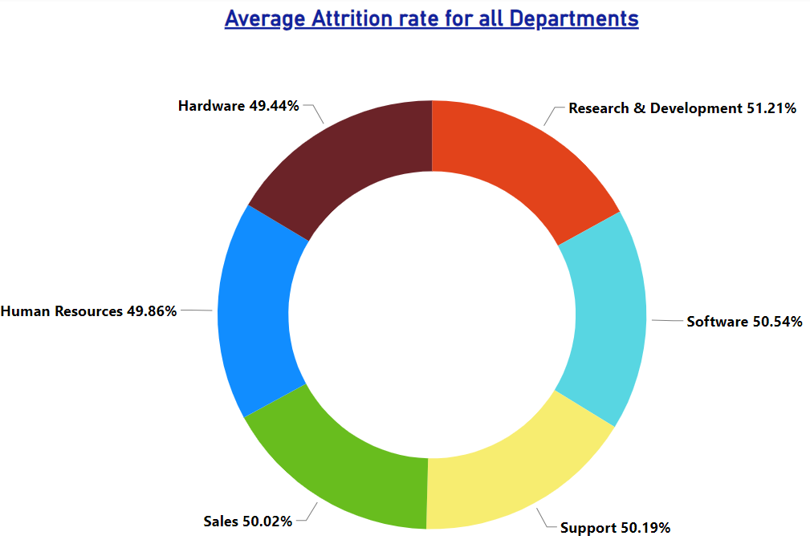
KPI- 1
Average Attrition Rate For All Departments
1
Event
This KPI highlights the connection between departments and attrition rates. The Research & Development Department faces higher attrition, suggesting potential issues. Meanwhile, the Hardware Department's lower rate indicates successful retention practices. By understanding these patterns, the organization can tailor strategies to address specific departmental needs, fostering overall employee satisfaction and retention.
Business professionals
like you connecting.
2
5
Location
3
6

Slide 6
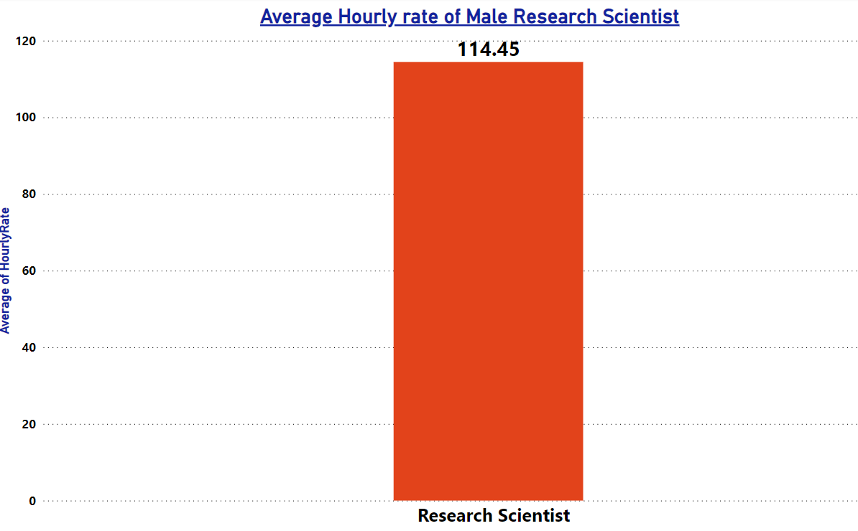
KPI- 2
Hourly Rate of Male Research Scientist
This key performance indicator (KPI) is centered on ascertaining the average hourly pay rate for male research scientists within the organization, which currently stands at $114.45. This metric not only provides insights into the compensation standards for this specific role but also serves as a benchmark for evaluating salary scales and fairness across similar positions.

Slide 7
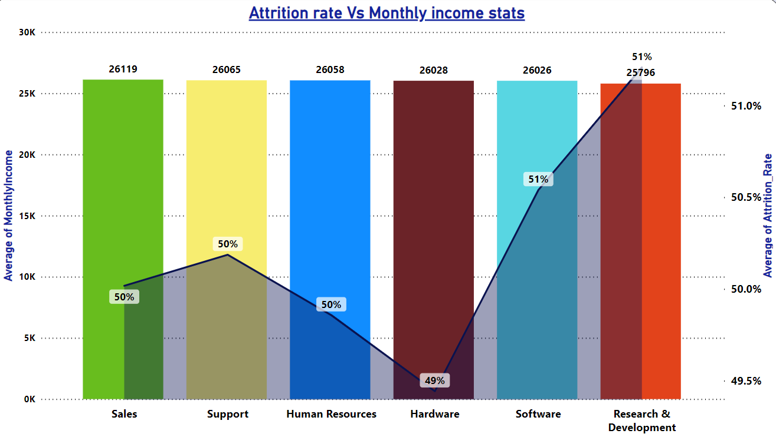
KPI- 3
Attrition Rate Vs Monthly Income Stats
This key performance indicator (KPI) is designed to explore the correlation between monthly income and the attrition rate, aiming to understand how salary levels impact employee turnover.

Slide 8
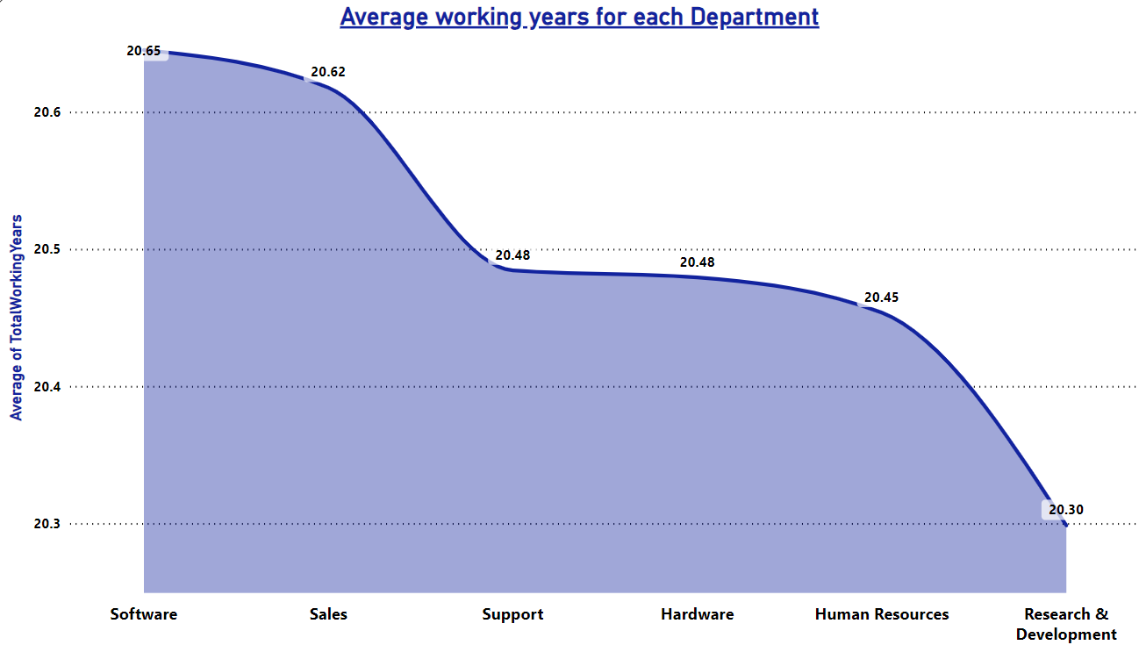
KPI- 4
Average Working Years for each Department
Upon analysis, it becomes evident that the Software Department has a notably higher average working tenure compared to other departments, while the Research & Development Department exhibits the lowest. The overall conclusion drawn is that the average working tenure across all departments hovers around 20 years.

Slide 9
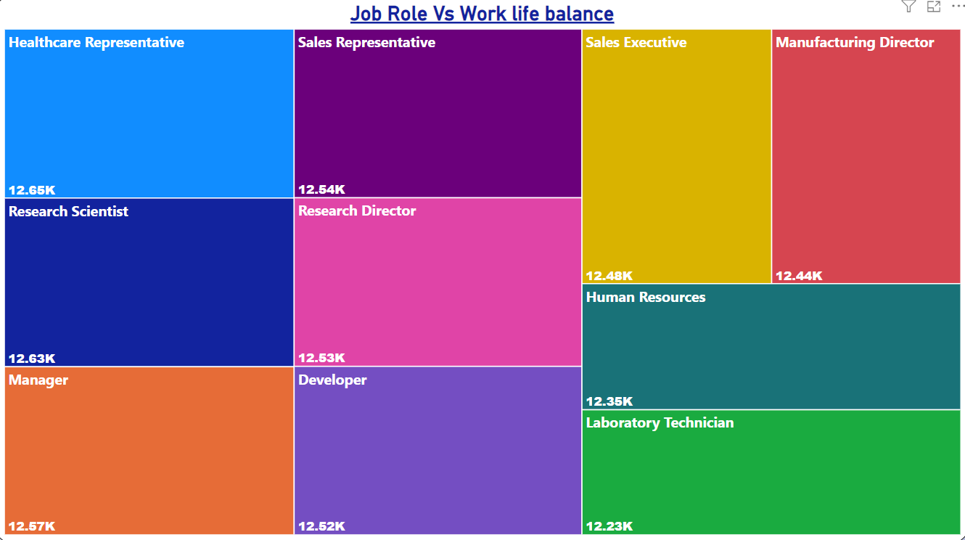
KPI- 5
Job Role Vs Work Life Balance for Total Employees
Human Resources and Laboratory Technicians experience poor work-life balance.
Sales Representatives, Managers, Manufacturing Directors, and Sales Executives have a fair level of work-life balance.
Research Scientists, Healthcare Representatives, and Developers enjoy a good work-life balance.
Employees in the Human Resources department report an excellent work-life balance.

Slide 10
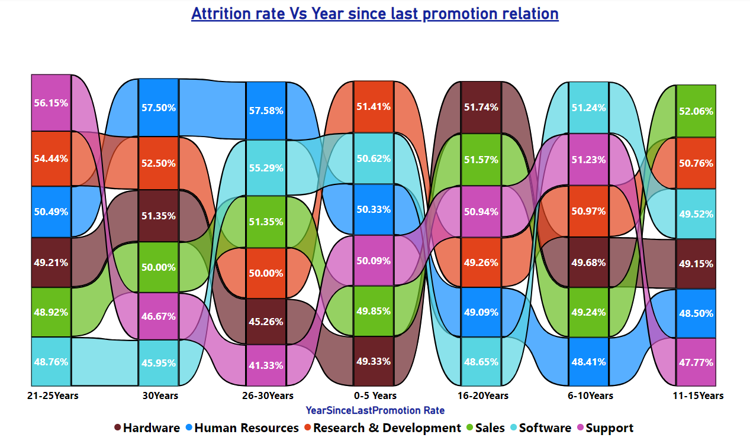
KPI- 6
Attrition rate Vs Year since last promotion relation

Slide 11
KPI- 6
Attrition rate Vs Year since last promotion relation
Between 0-5 years post-last promotion, the Research & Development department shows the highest attrition rate, in contrast to Hardware, which shows the lowest.
From 6-10 years after the last promotion, the Human Resources department registers the highest attrition, while Software records the lowest.
In the 11-15 year interval post-promotion, Support sees the highest attrition, whereas Sales experiences the lowest.
Looking at 16-20 years after promotion, the Software department exhibits the highest attrition, with Hardware at the opposite end with the lowest.
For the 21-25 year range since the last promotion, the Software department again tops in attrition, with Support at the minimum.
During 26-30 years following a promotion, Support encounters the highest attrition, while Human Resources shows the lowest.
Finally, for intervals exceeding 30 years since the last promotion, Software has the highest attrition rate, and Human Resources has the lowest.
Based on the analysis and visual data

Slide 12
Conclusion
Talk with employees who are staying: Instead of asking people who leave, talk to those who stay and find out what they think about their job.
2.Make employees more involved: Do things that make employees feel more involved, like giving them feedback regularly, recognizing their good work, and offering chances for them to grow in their careers.
3.Make sure the workload is reasonable: Check regularly to make sure employees have a manageable amount of work. This helps avoid them feeling too stressed or overwhelmed.
4.Make the workplace positive: Create a happy and positive workplace by encouraging everyone to treat each other well, including everyone, and working together as a team. Encourage everyone to talk openly and work together.
5.Make sure pay is fair: Check that employees are paid well for their work. Understand what motivates them to keep working for the company.

Slide 13
THANK YOU

